Slide 1
HOSPITAL PATIENT ANALYSIS
POWERBI CAPSTONE PROJECT DONE BY EIGBE FAVOUR OFURE

Slide 2
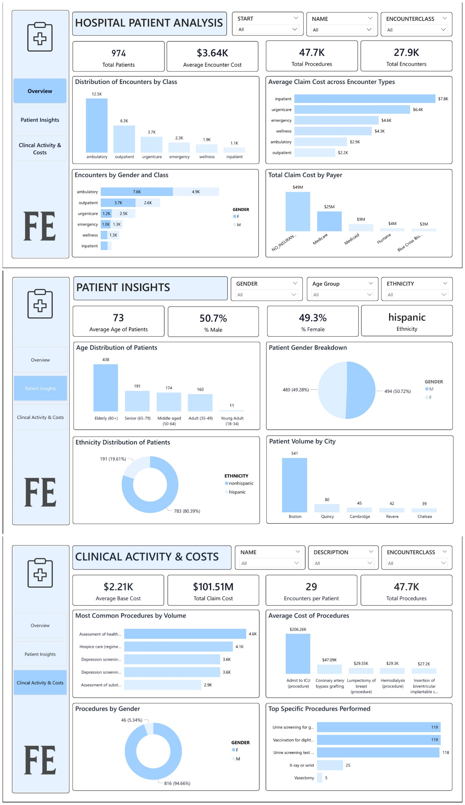
HOSPITAL MANAGEMENT ANALYSIS

Slide 3
INTRODUCTION
This project uses interactive Power BI dashboards to evaluate hospital performance across operations, patients, and clinical activities.
It highlights claim costs, encounter volumes, procedure types, and demographics, showing how patient activity connects to financial outcomes.
The goal is to guide better hospital management and improve patient care.

Slide 4
OBJECTIVES
The objective is to analyze hospital performance across encounters, payers, and patient demographics to identify high-demand and high-cost areas.
By linking clinical activity with financial outcomes, the dashboard supports decisions that improve efficiency, optimize resources, boost revenue, and enhance patient care.

Slide 5
BUSINESS QUESTIONS
OVERVIEW
Which encounter classes (ambulatory, outpatient, inpatient, etc.) are most common?
Which encounter class has the highest average claim cost?
How do encounter classes vary by gender (male vs female)?
Which payers (e.g., Medicare, Medicaid, uninsured) are covering the largest share of costs?

Slide 6
BUSINESS QUESTIONS
PATIENT INSIGHTS
What is the age distribution of patients?
What is the gender breakdown of patients?
What is the ethnicity distribution (Hispanic vs non-Hispanic)?
Which cities contribute the most patients?

Slide 7
BUSINESS QUESTIONS
CLINICAL ACTIVITY AND COSTS
What are the most common procedures/encounter types performed?
Which procedures are the most expensive on average?
How are procedures distributed across male and female patients?
What are the top specific procedures (e.g., screenings, vaccinations, X-rays)?

Slide 8
DATA DESCRIPTION
Encounter Table
id → unique encounter identifier
start, stop → start and stop timestamps of the encounter
patient → patient id (links to patient’s dataset)
organization → organization id (links to organizations dataset)
payer → payer id (links to payer’s dataset)
encounterclass → type of visit (inpatient, outpatient, emergency, etc.)
code, description → medical coding and description of encounter
base_encounter_cost → base cost of the encounter
total_claim_cost → total amount claimed for reimbursement
payer_coverage → portion of claim covered by payer
reasoncode, reasondescription → code and description for reason of visit

Slide 9
DATA DESCRIPTION
Organizations Table
id → organization identifier
name → organization name
address, city, state, zip → location information
lat, lon → geographic coordinates

Slide 10
DATA DESCRIPTION
Payers Table
id → payer identifier
name → payer/insurance company name
address, city, state_headquarter, zip → company headquarters info
phone → contact number

Slide 11
DATA DESCRIPTION
Patients Table
id → patient identifier
birthdate, deathdate → date of birth and death (if applicable)
prefix →name prefix, such as mr., mrs., dr., etc.
suffix → name suffix, such as phd, md, jd, etc.
first, last, maiden → patient’s names
marital → marital status
race, ethnicity → race and ethnicity
gender → gender
birthplace → birth location
address, city, state, county, zip → current address info
lat, lon → geographic coordinates

Slide 12
DATA DESCRIPTION
Procedure Table
start, stop → time of procedure
patient → patient id (links to patient’s dataset)
encounter → encounter id (links to encounters dataset)
code, description → medical coding and description of the procedure
base_cost → base cost of the procedure
reasoncode, reasondescription → reason for procedure

Slide 13
DATA PREPARATION
The hospital patient record dataset was first gotten from Maven Analytics Data Playground as agreed by my group after which it was imported to power bi and then the following was done in power query:
Checking for duplicates
we checked for duplicates, and none was found
Handling missing values
we checked for blanks, and none was found.
data types
we checked data types and changed it where necessary and after all this was done i closed and loaded after which I created my measures and column

Slide 14
DATA PREPARATION
Creating measures
I created a new table called calculations and then I created some measures for my analysis, and they are: Total Patients, Total Encounters, Total Procedures, Total Claim Cost, Average Encounter Cost, Average Age, Male Patients, Female Patients, % Male, % Female, Average Encounter Cost, Encounters per Patient, Total Payer Coverage, YoY Patient Growth %, Number of Patient previous and current year.
Creating calculated column
I created some calculated columns for my analysis, and they are: Age, Age Group, Age Group Sort

Slide 15
ANALYSIS AND FINDINGS
KEY PERFORMANCE INDICATORS (KPIs):
OVERVIEW PAGE
Total Patients (974): Number of unique patients in the dataset.
Total Claim Cost ($101.51M): Sum of all healthcare claim costs submitted.
Total Procedures (47.7K): Number of procedures performed across all encounters.
Total Encounters (27.9K): Total number of hospital visits (inpatient, outpatient, emergency, etc.).
Average Encounter Cost ($3.64K): Average financial cost per patient encounter, calculated as total claim cost ÷ encounters.

Slide 16
ANALYSIS AND FINDINGS
KEY PERFORMANCE INDICATORS (KPIs):
PATIENT INSIGHTS PAGE
Average Age of Patients (73): The mean age of all patients, showing an elderly-dominant population.
% Male (50.7%) & % Female (49.3%): Gender distribution of the patient base.
Ethnicity (% Non-Hispanic 80.4%, Hispanic 19.6%): Ethnic breakdown of the patient population.

Slide 17
ANALYSIS AND FINDINGS
KEY PERFORMANCE INDICATORS (KPIs):
CLINICAL ACTIVITY AND COSTS
Average Base Cost ($2.21K): The mean base cost of medical procedures.
Encounters per Patient (29): Average number of encounters per patient, reflecting how often patients return.
Total Encounters (47.7K): Same as overview, but here it supports procedure-level analysis.

Slide 18
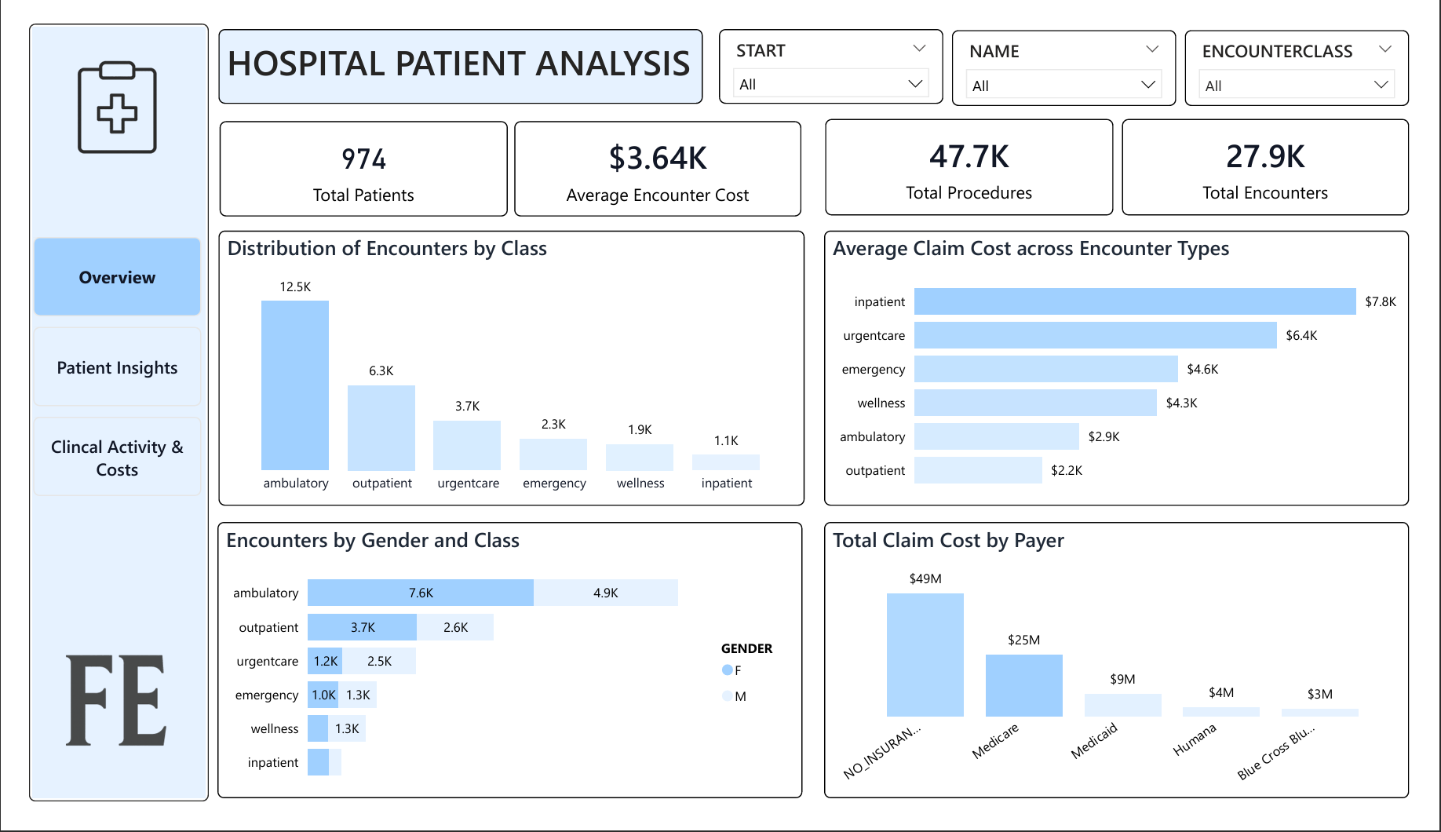
OVERVIEW PAGE
The hospital has 974 patients, with 27.9K encounters and 47.7K procedures.
Ambulatory (12.5K) and outpatient (6.3K) dominate encounter volume, while inpatient has the lowest (1.1K).
Inpatient encounters are the costliest ($7.8K each), while outpatient is the cheapest ($2.2K).
Uninsured patients account for nearly half of all claim costs ($49M), while Medicare covers the next largest share ($25M).
Gender differences appear in encounter classes: female patients drive more outpatient visits.

Slide 19
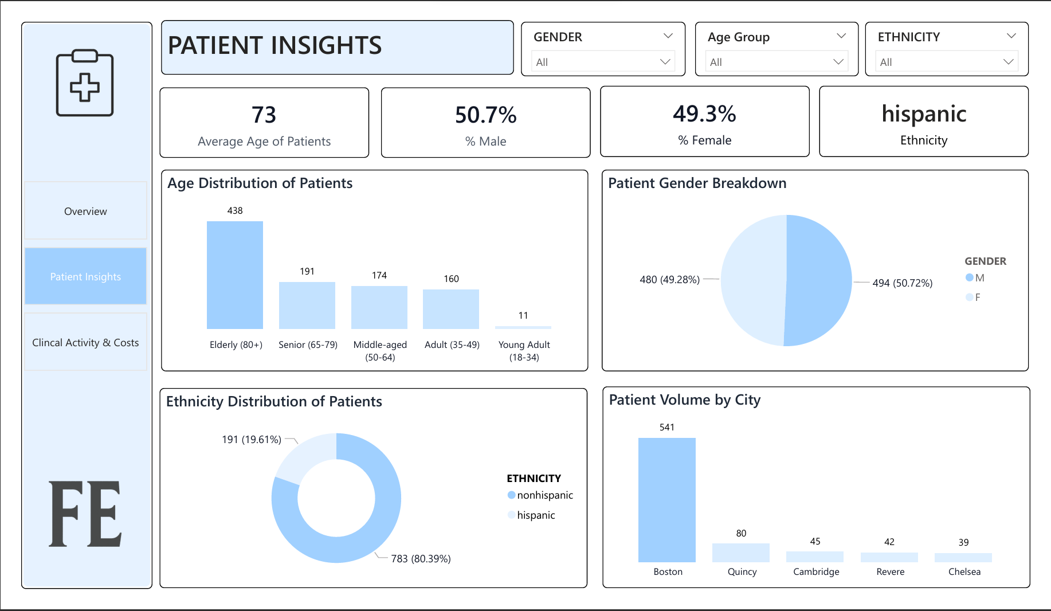
PATIENT INSIGHT
Elderly patients (80+) dominate with 438 cases, while young adults (18–34) are the smallest group with only 11 cases.
The patient base is almost evenly split, with 50.7% male and 49.3% female
Non-Hispanic patients make up the majority (80.4%), while Hispanic patients account for 19.6%.
Boston leads with 541 patients, far higher than Quincy (80) and other smaller cities

Slide 20
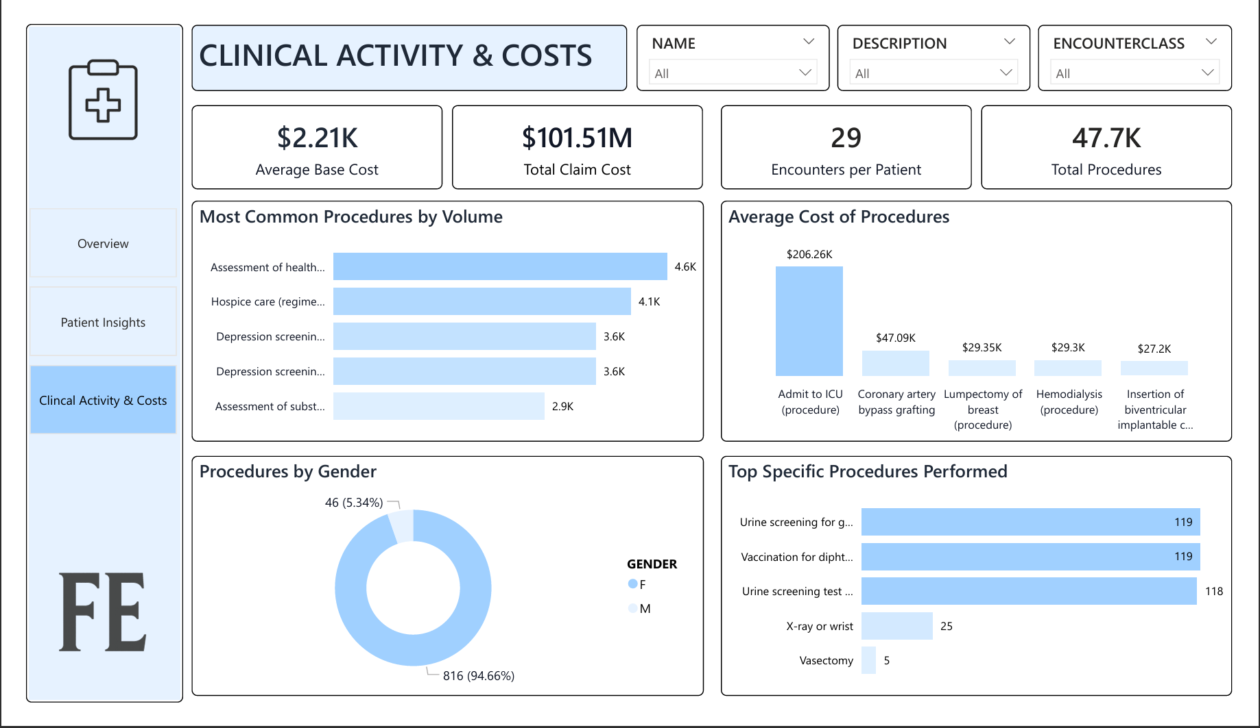
CLINICAL ACTIVITY AND COSTS
Most common procedures: assessment of health and social care needs (4.6K), hospice care (regime/therapy): 4.1K, depression screening using patient questionnaire two-item score (3.6K), substance use assessments (2.9K).
Most expensive procedures: ICU admission ($210K), coronary artery bypass graft ($50K), lumpectomy of breast ($30K).
Routine urine screenings (118–119 each) and vaccinations (119) dominate while X-rays (25) and vasectomies (5) are far less frequent, highlighting the hospital’s tilt toward preventive and diagnostic screenings over surgical or imaging interventions.
Female patients account for 95% of procedure volumes, reflecting women’s health services.

Slide 21
RECOMMENDATION
Financial Risk Management
Encourage uninsured patients to enroll in coverage programs to reduce their out-of-pocket burden and strengthen hospital revenue stability.
Geriatric and Chronic Care Programs
Expand dedicated services for seniors and elderly patients (65+), who represent most of the patient base.
Preventive and Mental Health Services
Scale up existing screening programs (depression, substance use, wellness checks) since they are high in volume and relatively low in cost.
Geographic Outreach & Service Balance
Patient volume is heavily concentrated in Boston; consider outreach clinics or partnerships in smaller cities (Quincy, Cambridge, Revere) to balance access.
Data-Driven Operations
Standardize reporting so leaders can monitor cost per encounter, procedure efficiency, and payer coverage in real-time.

Slide 22
CONCLUSION
With better financial risk management, stronger elderly and preventive care, and targeted outreach, the hospital can improve patient outcomes, optimize costs, and achieve long-term operational stability.

Slide 23
THANK YOU

